Slide 1
Document Object Model (DOM)

Slide 2

Document Object Model (DOM) and W3C
New DOM Concepts
Element Referencing Hierarchy of nodes Node properties Node methods Generating new node content Replacing node content
DOM Levels
DOM and JavaScript
Introduction

Slide 3
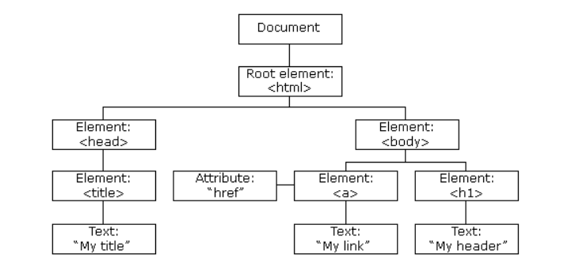
The HTML DOM Tree of Objects

Slide 4
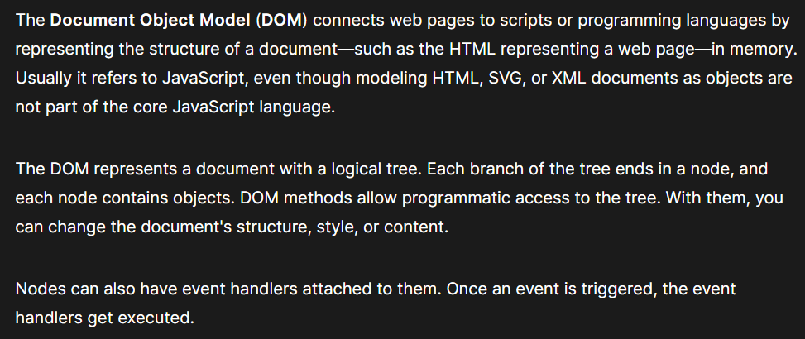
Document Object Model (DOM)
Reference: https://developer.mozilla.org/en-US/docs/Web/API/Document_Object_Model

Slide 5
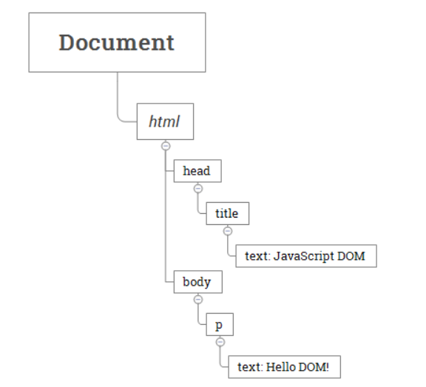
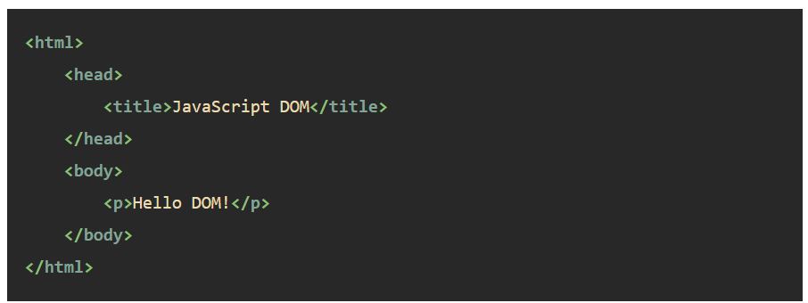
A document as a hierarchy of nodes

Slide 6
Classification of Nodes

Slide 7
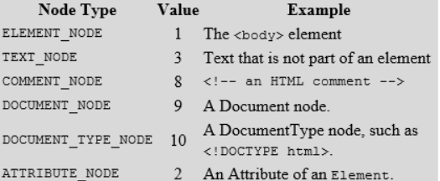
Classification of Nodes

Slide 8
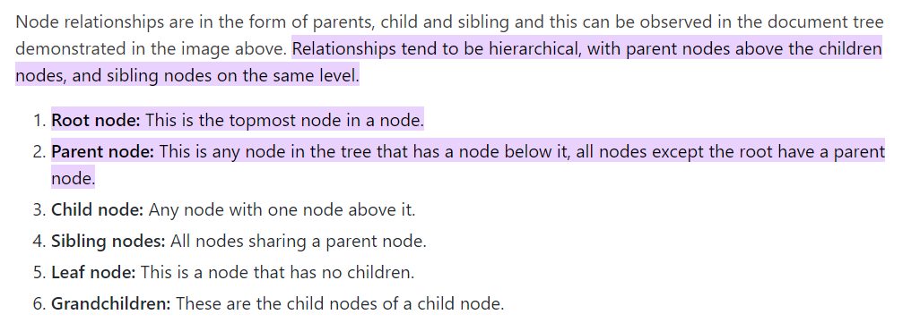
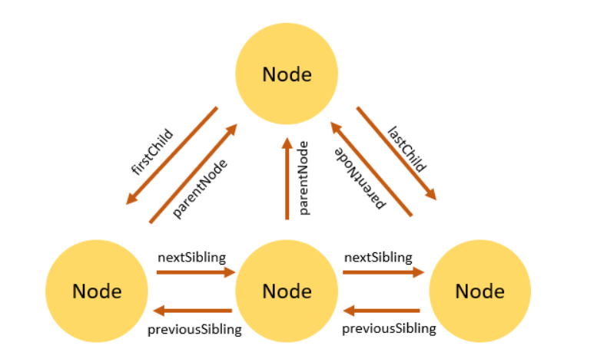
Node Relationships

Slide 9
Access every node in the HTML document
getElementById() method
using node relationships on the node tree
getElementsByTagName() method

Slide 10
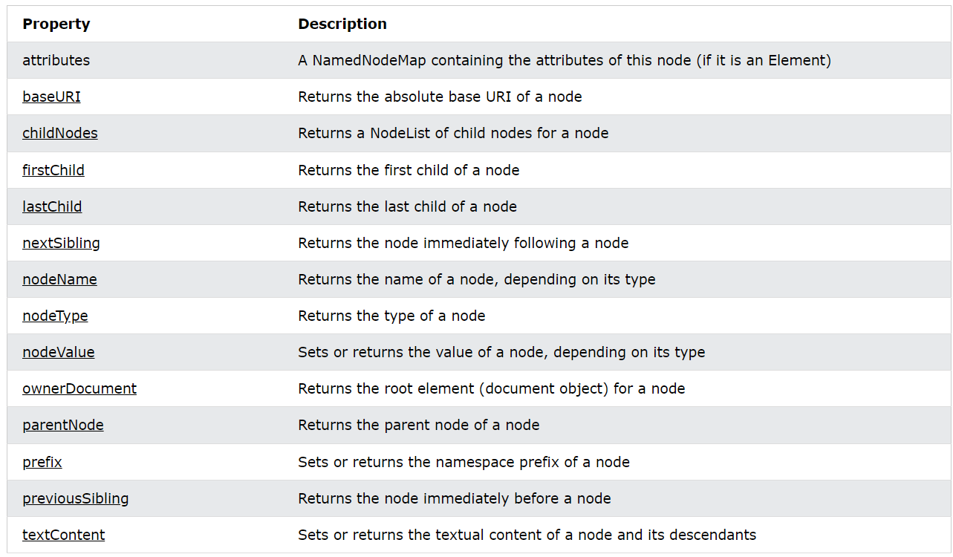
Node Object Properties

Slide 11
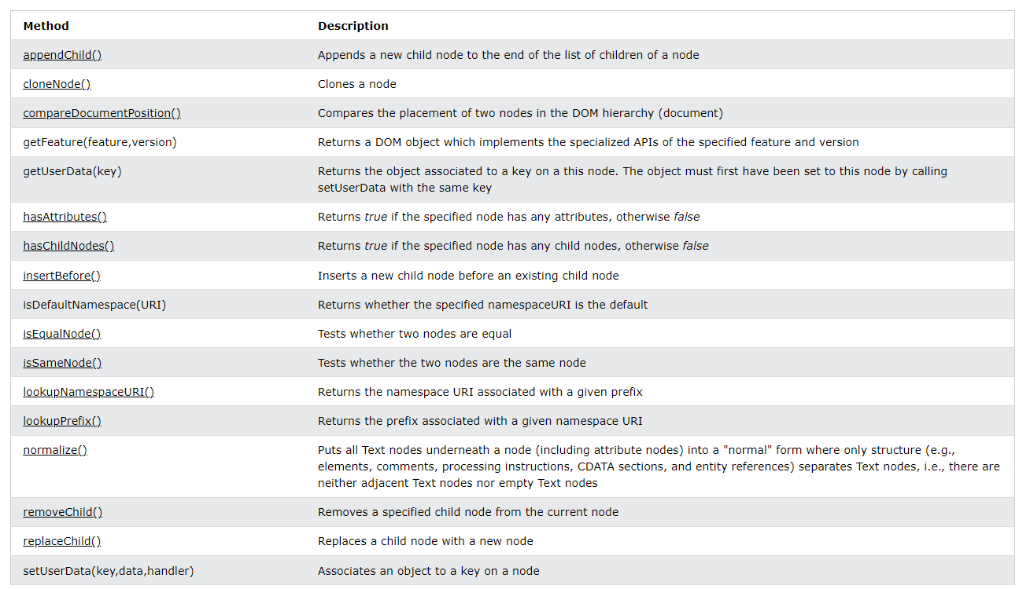
Node Object Methods

Slide 12
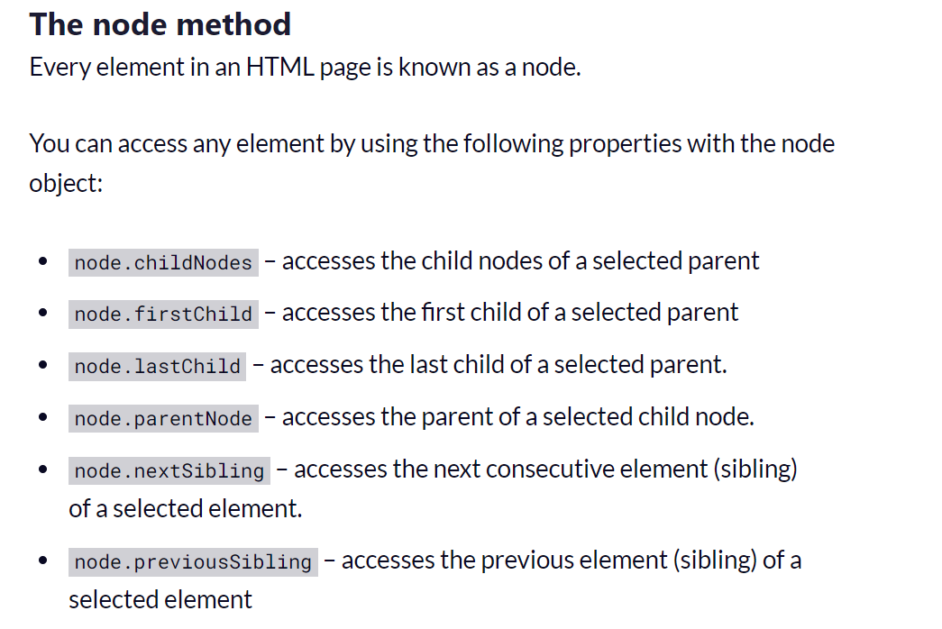
Element Referencing

Slide 13
Generating new node content - appendChild()

Slide 14
Generating new node content -insertBefore()

Slide 15
Removing Existing HTML Elements

Slide 16
Removing a Child Node

Slide 17
Replacing node content

Slide 18
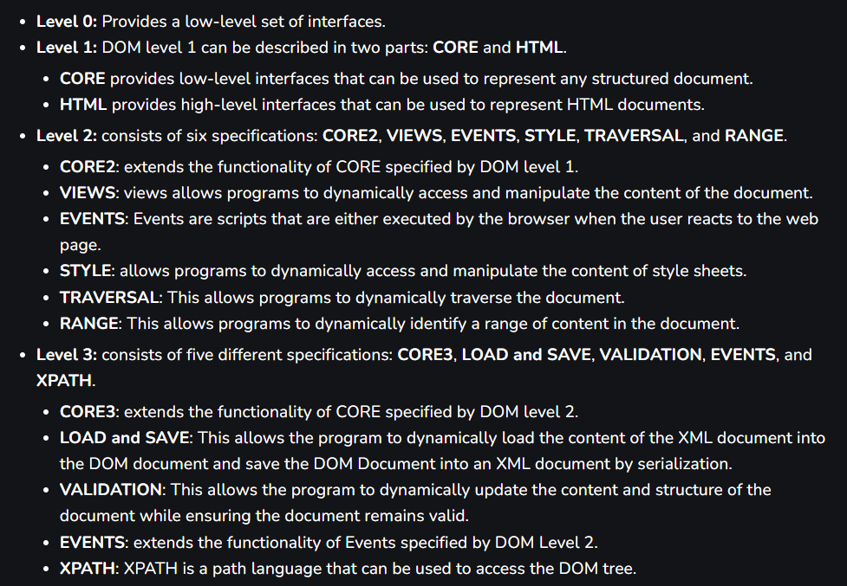
Levels of DOM

Slide 19
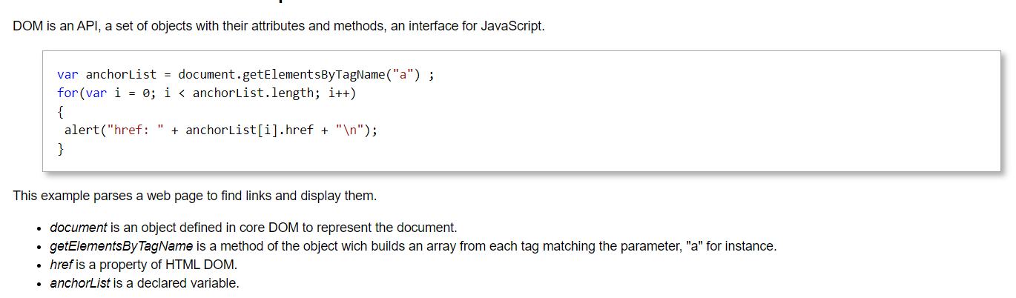
How to use DOM with JavaScript?

Slide 20
Document Object Model (DOM) and W3C
New DOM Concepts
Element Referencing Hierarchy of nodes Node properties Node methods Generating new node content Replacing node content
DOM Levels
DOM and JavaScript
Summary

